Slide 1
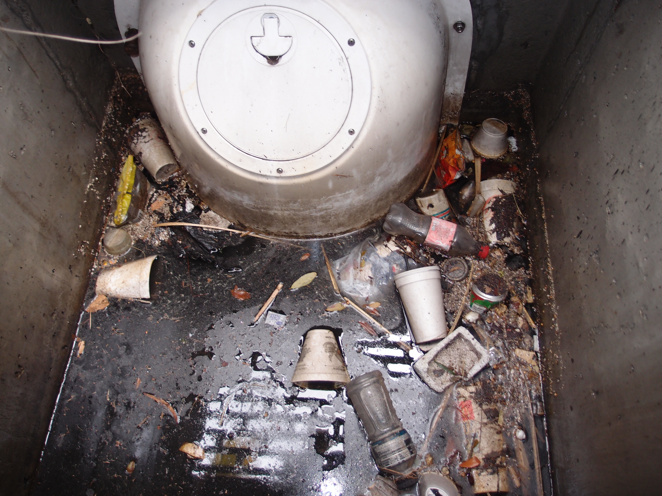
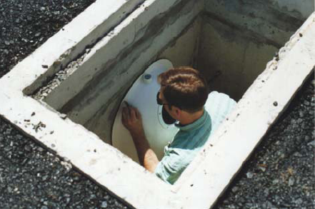
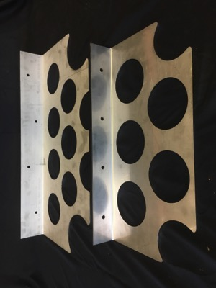
Turbulence and Velocity Reduction
In Stormwater Quality Structures

Slide 2
Presentation Goals
Understand how simple structural methods can be used to improve stormwater quality.
Examine hydraulic impacts of water quality control devices.
Discuss anti-turbulence plate product development and testing.
Learn how structure design impacts removal efficiencies.
Look at how flow rate and structure dimensions affect prediction modeling.
Brief look at on-going maintenance.

Slide 3
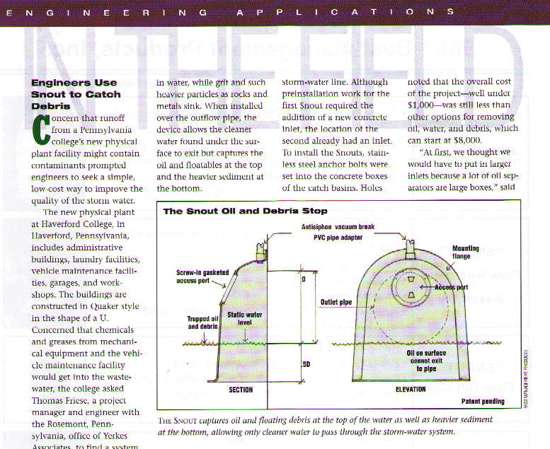
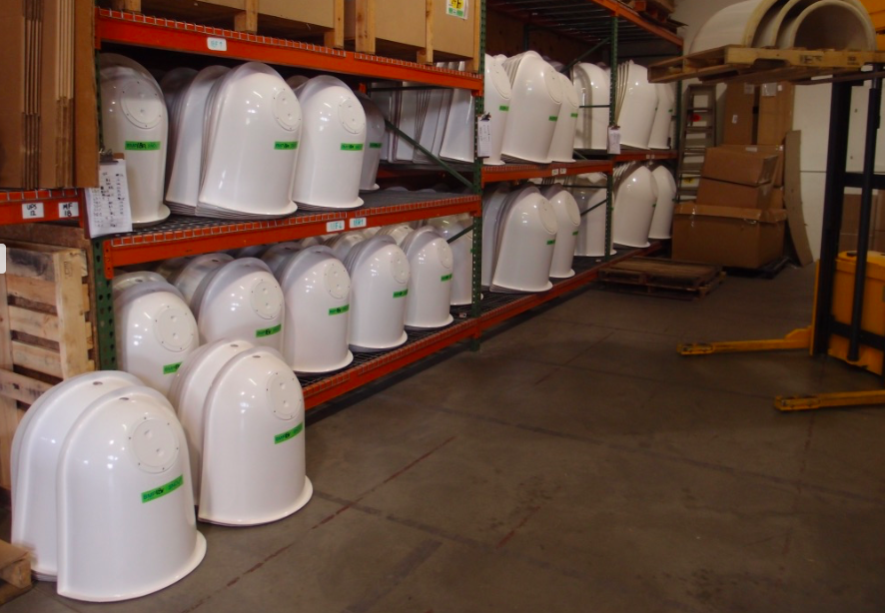
Our Background:
BMP, Inc. has been designing and manufacturing simple stormwater quality devices for over 22 years.
First commercial installation in 1999 was at Haverford College in Pennsylvania, featured in Civil Engineering Magazine.
Feature cost-effective stormwater devices for the Ultra-Urban Environment.
Focus is sediment, trash, floatables and hydrocarbon reductions.
More than 100,000 installations in North America.

Slide 4
Why Use Structural Methods For Stormwater Quality?
Urban and Ultra Urban settings may not have the space for land-based systems like ponds and infiltration fields.
Structural Methods can target specific pollutants.
To serve as pre-treatment for larger storage-based systems to reduce on-going maintenance or boost performance.
Structural Methods offer great flexibility for BMP placement.

Slide 5
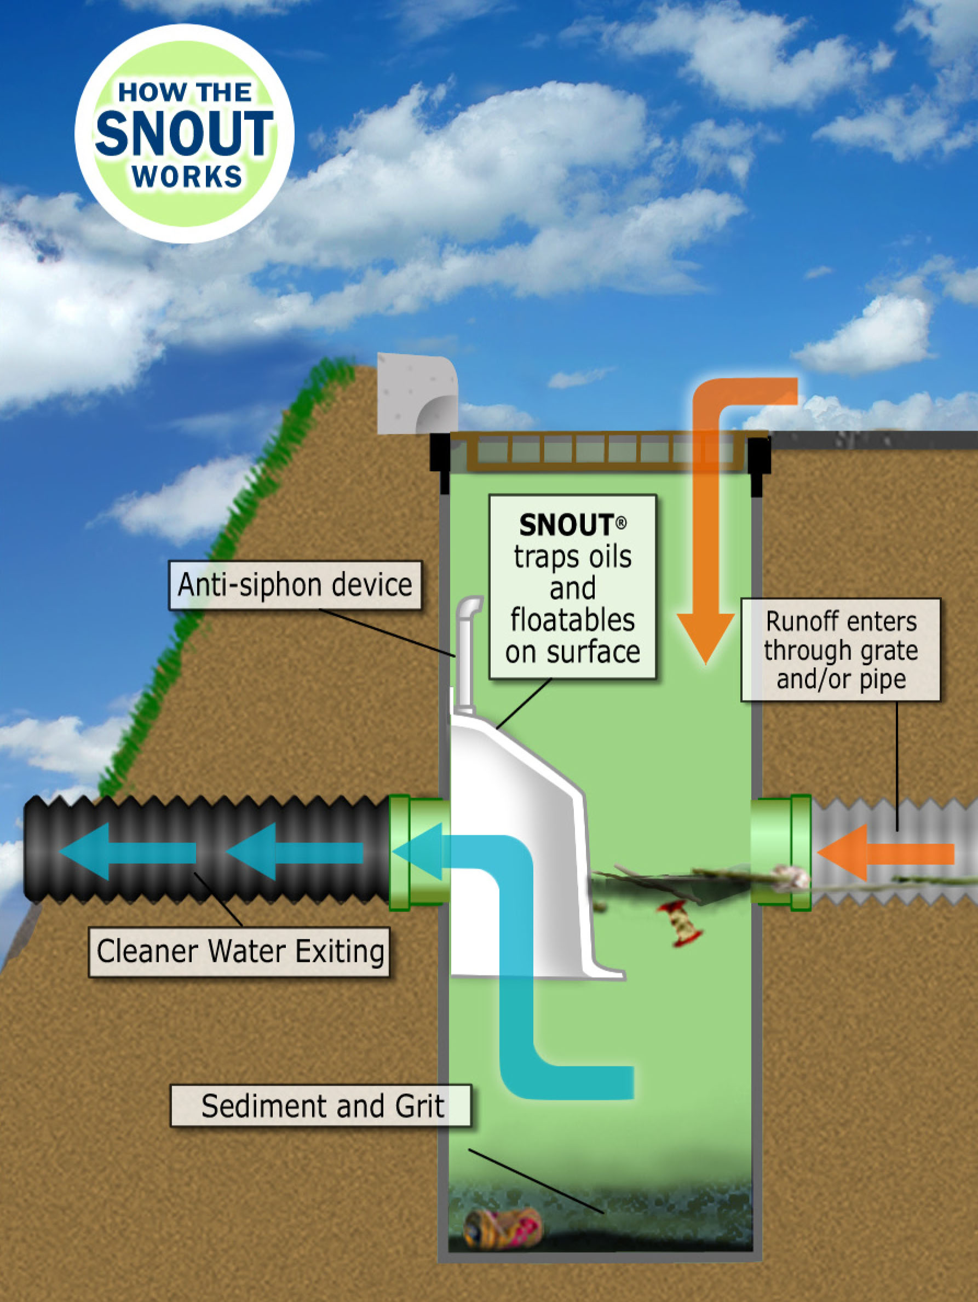
How Water Quality Hood Works
Anti-siphon vent prevents surface pollutants from getting sucked downstream from under the hood*
* Static water level will stay at pipe invert due to vent, preventing siphoning from occurring.

Slide 6
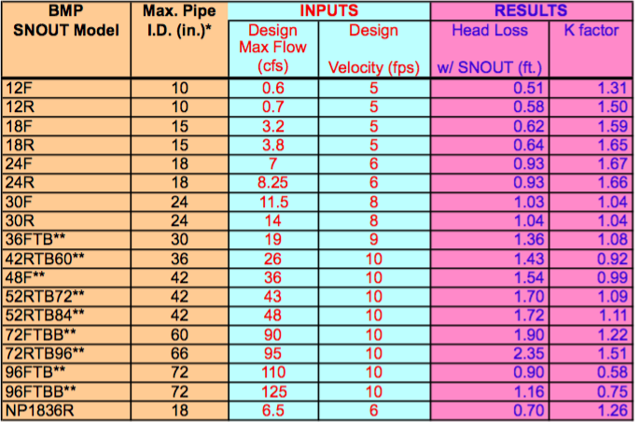
Hydraulic Considerations
Design note: Adding any stormwater quality device will have a hydraulic effect on your system. BMP provides a live spreadsheet where the user can plug in flow values in cfs and fps and get a head loss and K factor for any given SNOUT in “Hydraulics” folder on resources page of bmpinc.com.
If the proposed hood offers a loss that is too high for a given flow, simply upsize to the next model.

Slide 7
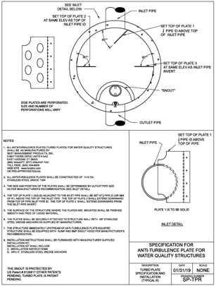
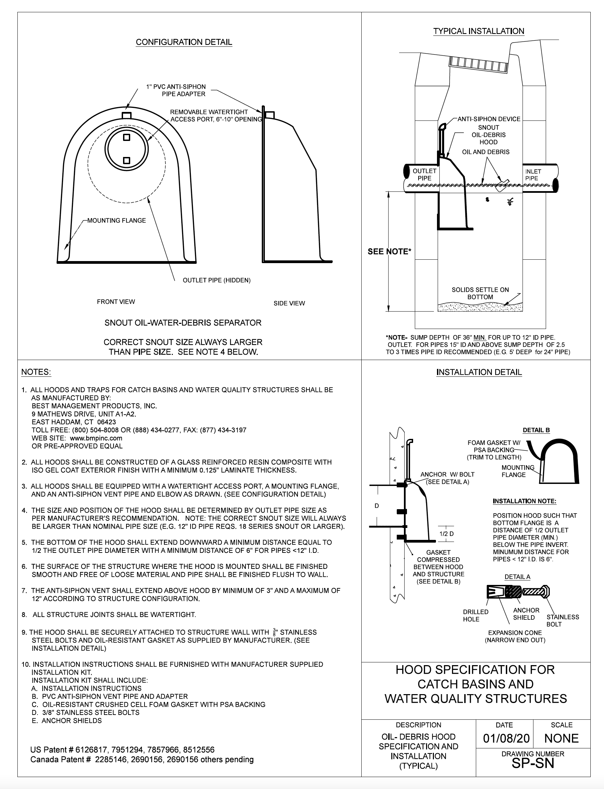
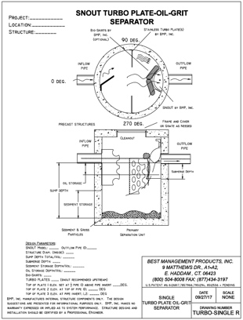
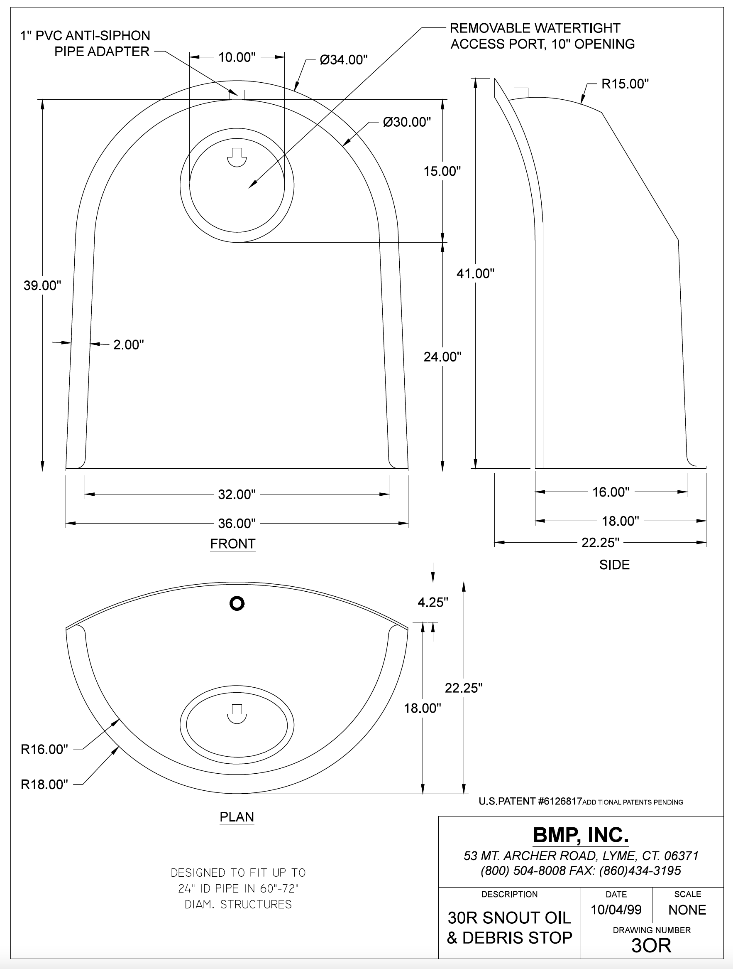
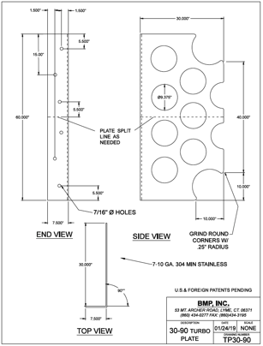
BMP SNOUT + Turbo Plate Spec and Resources
Specifications
SNOUT + Turbo Plate Part Details
Design Schematics

Slide 8
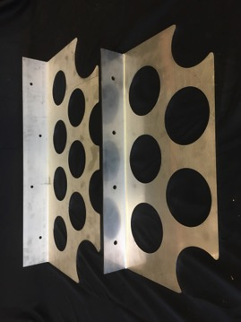
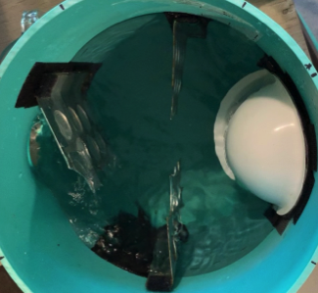
Turbulence Reducing “Turbo Plate®” Development
Goal was for retro-fit capable device to reduce turbulence and increase sediment capture.
Needed to be low cost to fit with BMP’s design philosophy.
Performance estimations through extensive lab testing and software calculated reporting.
Adaptable to various structure configurations and deployable in series for increased performance.

Slide 9
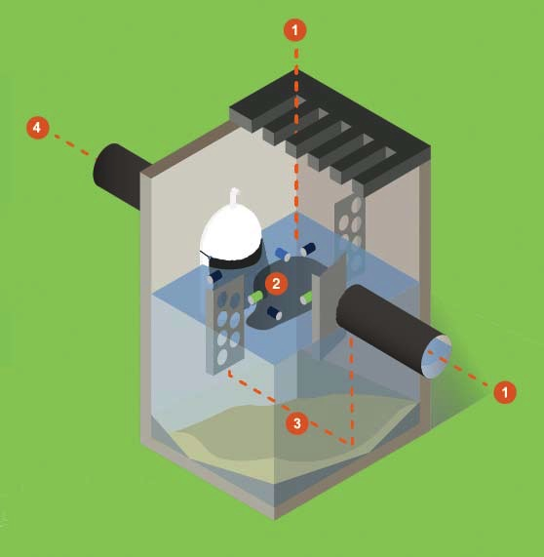
How a Hood and Turbo Plate® Anti-Turbulence Plates work together.
1. Flow enters through pipe.
Flow is intercepted at inlet and deflected toward perforated plates.
Velocity and turbulence are reduced.
Pollutants separate and settle.
Cleaner flow exits from under the hood.

Slide 10
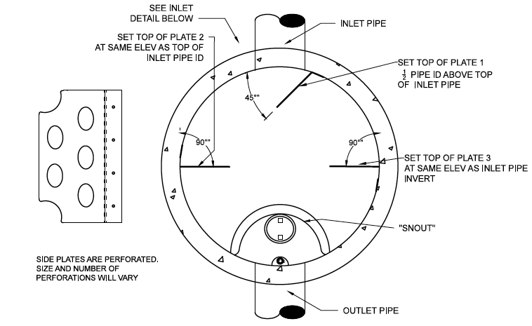
Designing with anti-turbulence plates
Inlet and Outlet pipe sizes, treatment flow and Qmax.
Hood, plate and structure sizes will be determined based on flow and treatment level.
Inlet plate is solid, and side plates are perforated.
Can be retrofitted into existing structure if sump depth is sufficient (3’ min)
When possible, structure with hood only upstream of anti-turbulence structure is recommended.
Hood and plates will work for round or rectangular structures and multiple inlet pipes if structure is appropriately sized.
Turbo-Plates are available for up to 36” Inlet Pipes (larger sizes considered custom parts).

Slide 11
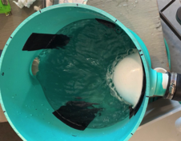
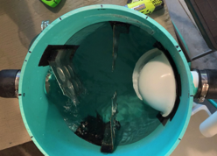
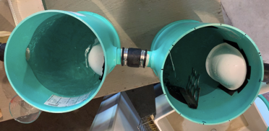
BMP Turbo Plate In-House Lab Tests
More than 50 ¼ scale tests conducted- 41 with Turbo Plates. Flow simulated 1.0 to 1.5 cfs flow in a 48” ID structure with 4’ sump and 18R SNOUT. Results consistent with minimal deviation.

Slide 12
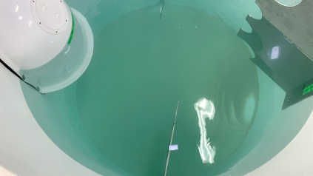
Testing at Alden Labs, Holden, MA
Initial Conditions
At 30 Minutes
SNOUT alone saw 64% removals and was boosted with 3 Turbo Plates to 80% at 225 gpm. The smaller, more difficult particles are removed by Turbo Plates.

Slide 13
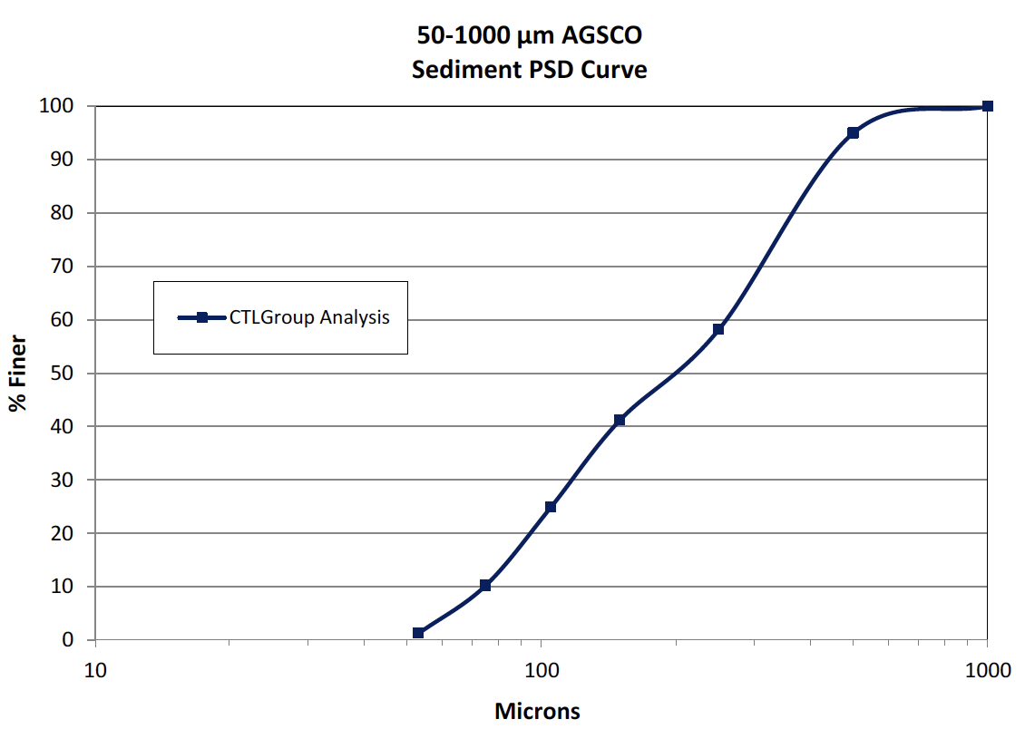
Test flow of 0.5 cfs in 5’ ID structure with 4’ deep sump yielded 80% removals.
Test sediment Particle Size Distribution curve for 50-1000 microns shown above.
This PSD is used for modeling.
Full report from Alden Labs is available.

Slide 14
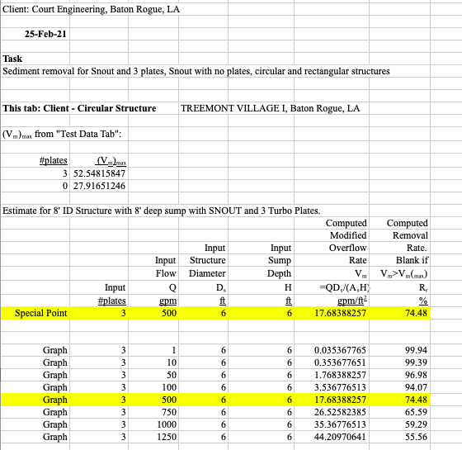
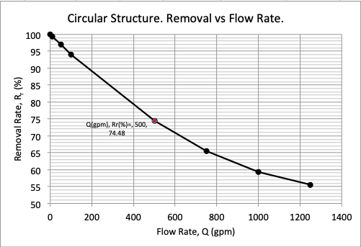
Turbo Plate Performance Prediction Software
Inputs: Flow Rate, Structure Size, Sump Depth, Pipe Sizes, BMP Components

Slide 15
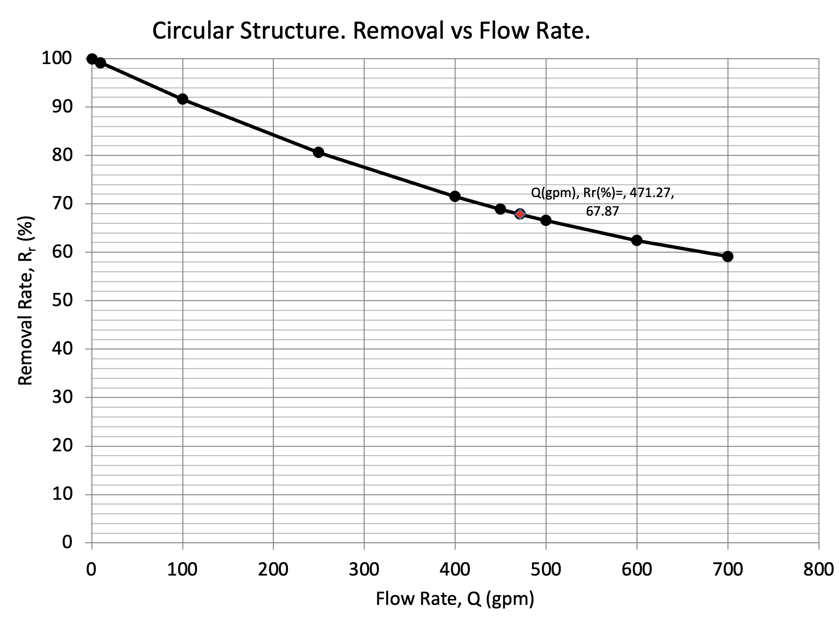
Modeling Software Performance Prediction Project in MN with 65% Treatment Goal

Slide 16
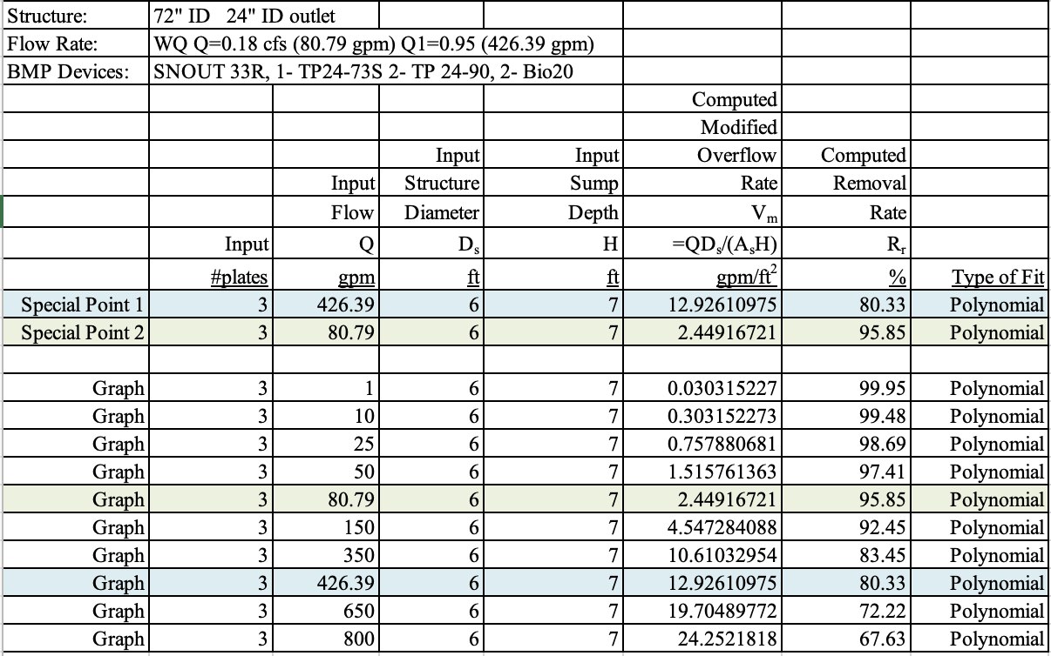
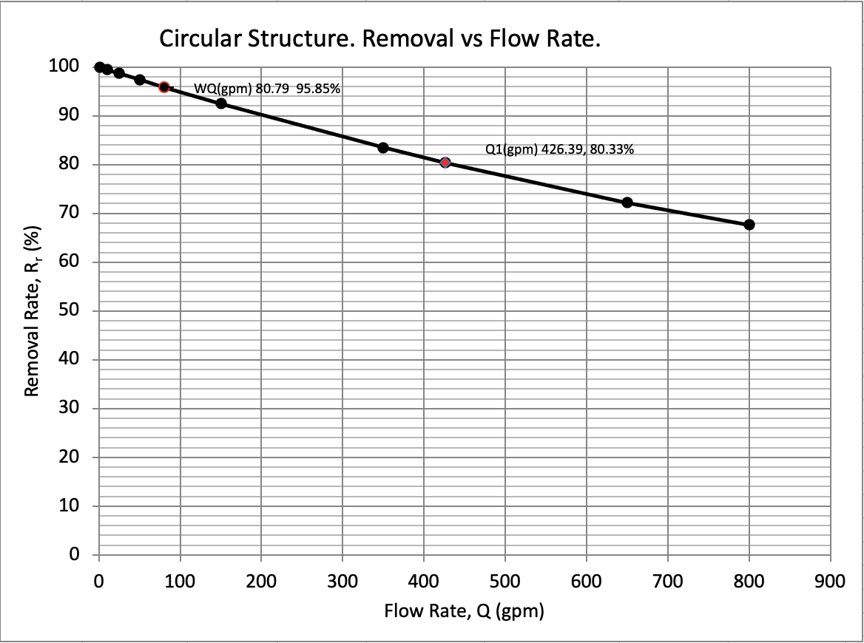
Modeling Software Performance Prediction Project in GA with 80% Treatment Goal

Slide 17
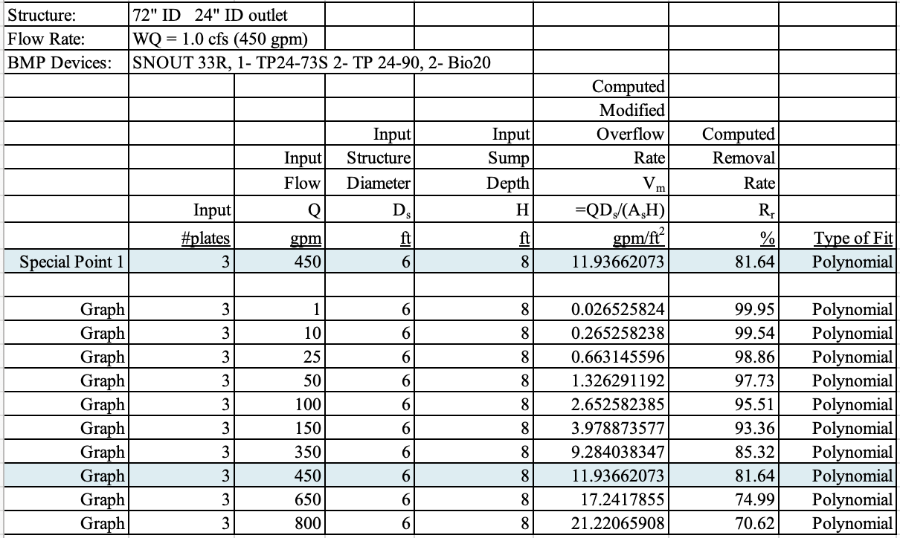
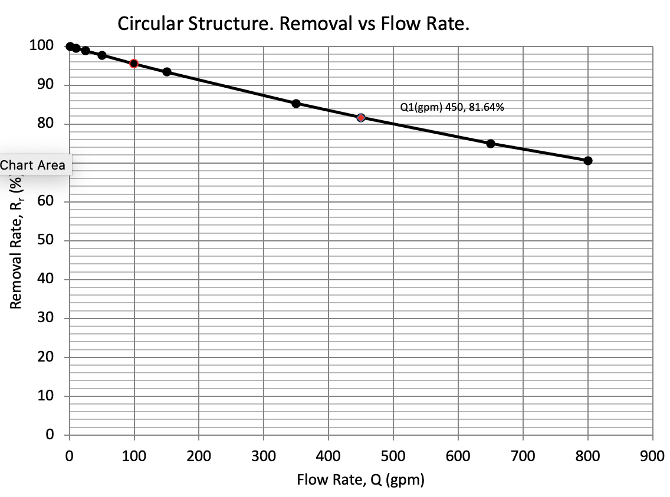
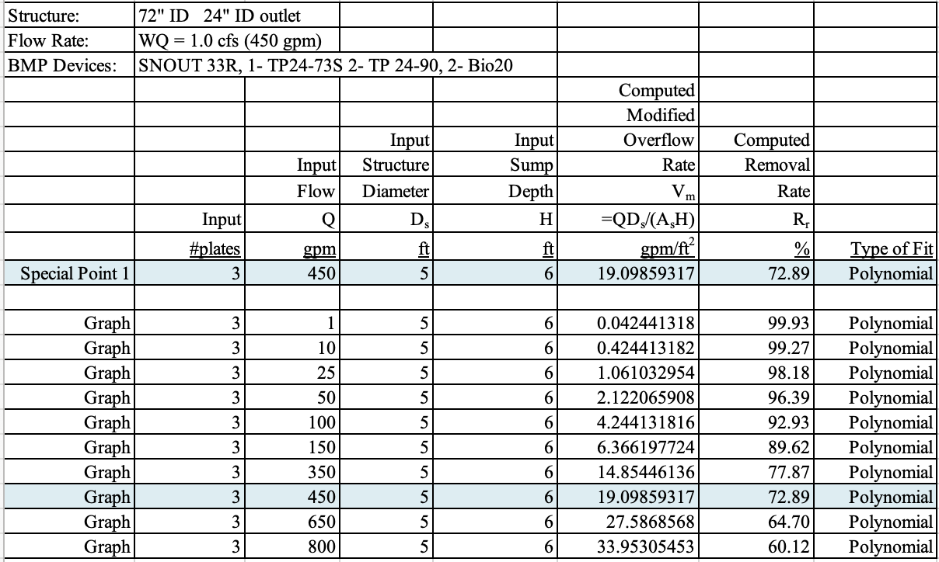
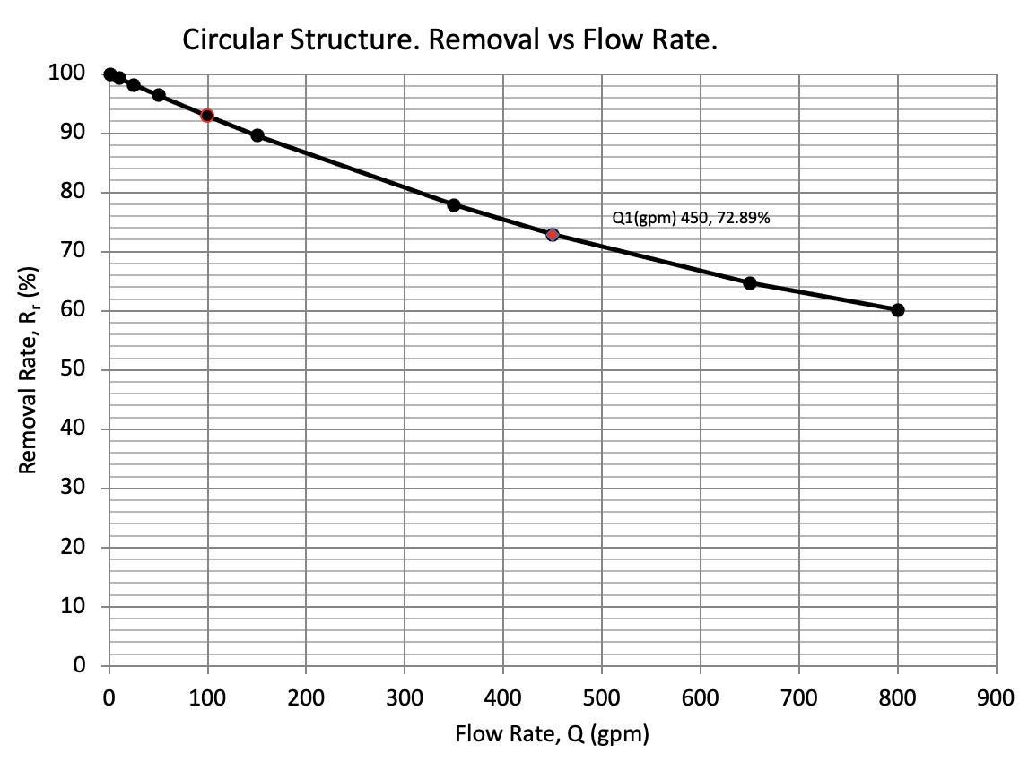
How Structure Dimensions Affect Performance
Q= 1.0 cfs (450 gpm)
Structure ID 6’
Sump Depth 8’
Removal Estimate= 81.64%
Q= 1.0 cfs (450 gpm)
Structure ID 5’
Sump Depth 6’
Removal Estimate= 72.89%

Slide 18
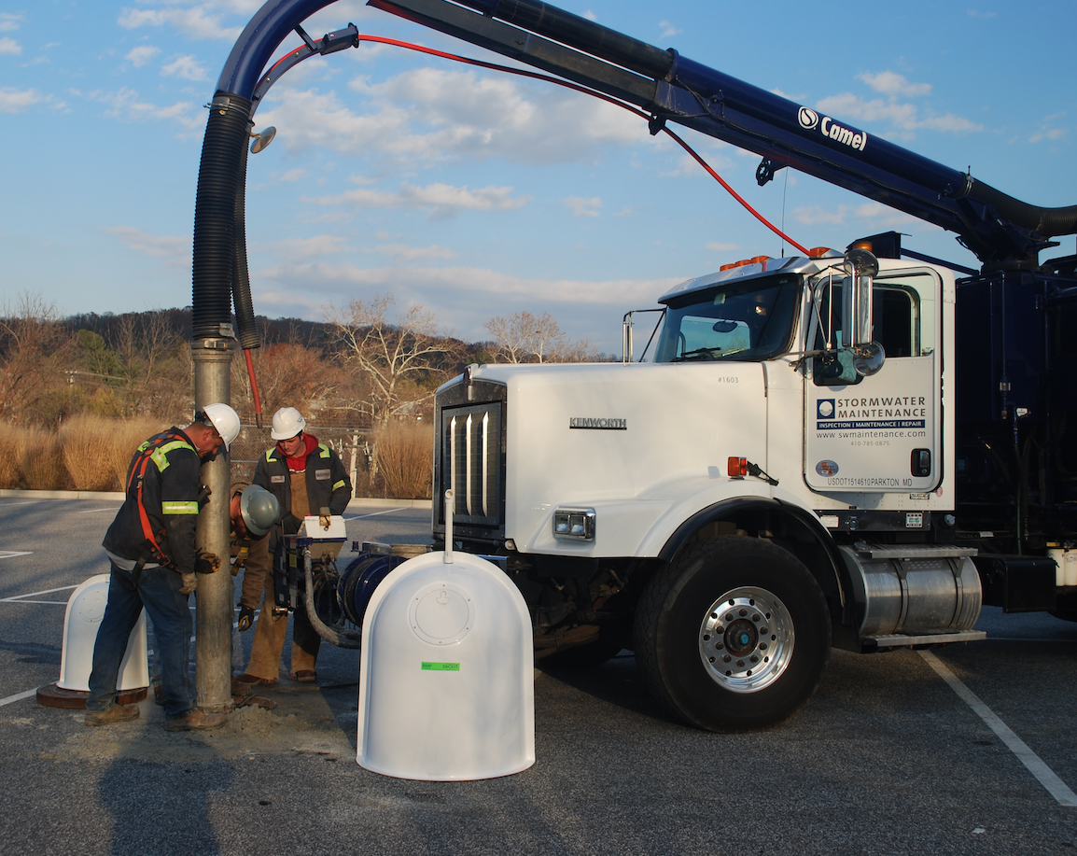
Maintenance Considerations
Maintenance with Vac Truck is recommended.
Clean structure when sump is more than half full (e.g < 2’ of material in 4’ deep sump).
Bio-Skirts to be wrung out and washed when only 1/3 floating above surface.
All structures should be monitored annually.
Structures with Turbo Plates and Stainless TrashScreens will capture more pollution and require closer monitoring.

Slide 19
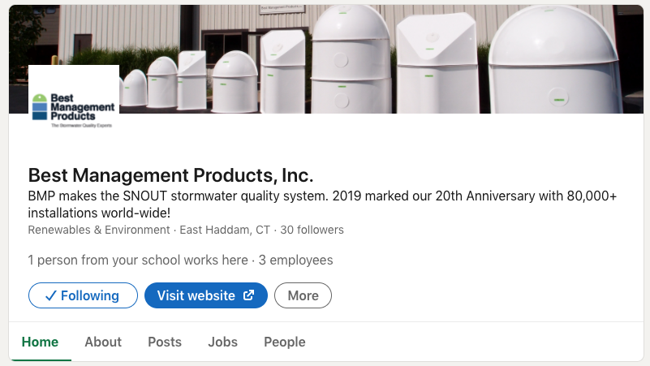
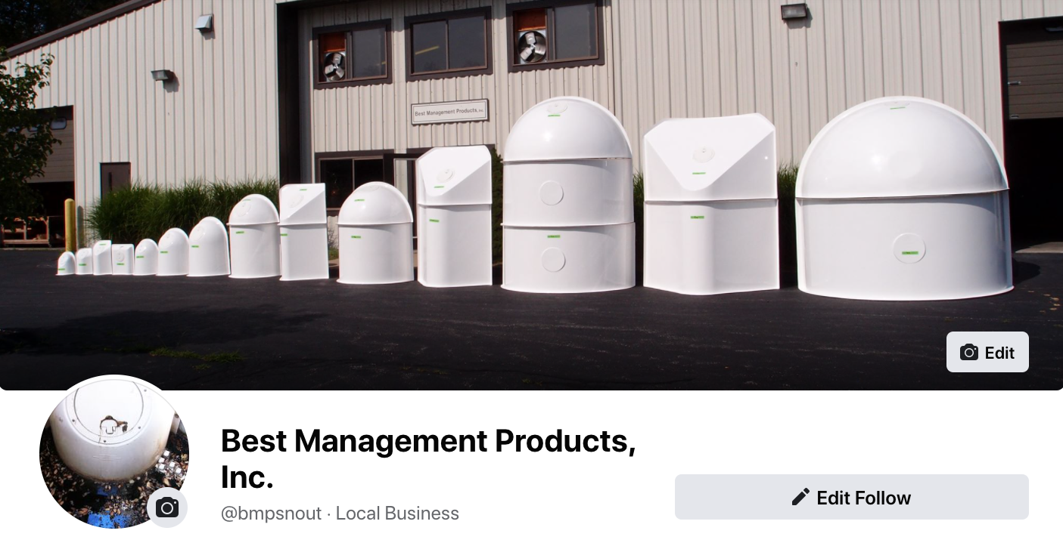
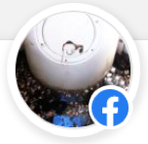
Follow and Like Best Management Products on Social Media!
LinkedIn
We post every week to provide you with the latest company information and to offer design options.
Facebook

Slide 20
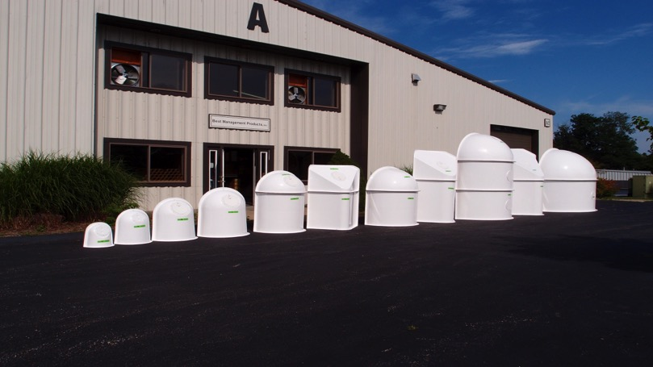
Thank you!
9 Matthews Drive, Unit A1-A2
East Haddam, CT 06423
USA
800-504-8008
www.bmpinc.com
Engineering Contacts:
T. J. Mullen
tjm@bmpinc.com
Matthew White, PE
mwhite@bmpinc.com

